Slide 1
FBI
Development
ATOMIC
CLOCK
Neighbors
Presidnet 2pac
Work
Roth.ibm.damiler.(visa).*
INTERNET(web ster biggie)
PENTAGON(deeree park 2pac)
KING(bismark)
crack
FBI:VIOLENCE CRIME:GANGS
biggie

Slide 2
FBI
Development
crack

Slide 3

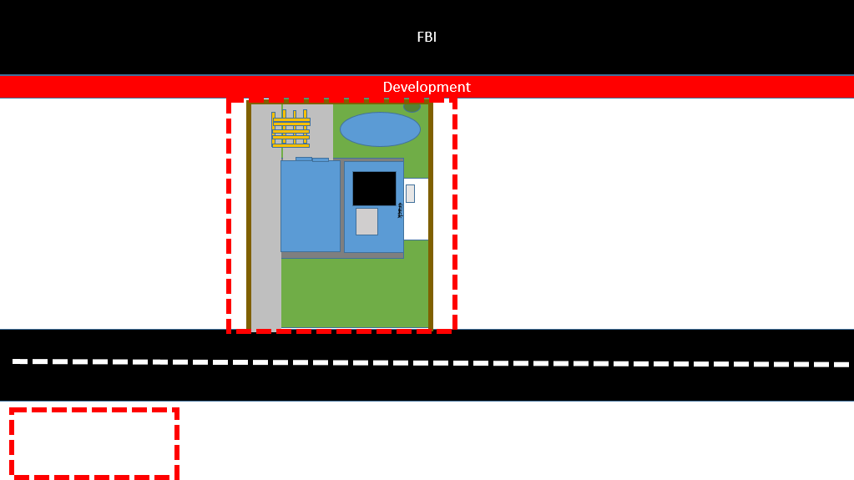

FBI
development
docs

Slide 4
FBI
Development
ATOMIC
CLOCK
Ibm.damiler.Apple.davision
[x] no
Phil(kim).McCARTHY: Twins, Visa oj
[x] no
crack
SQ.ibm
Ibm.damiler.Apple.davision
Ibm.damiler.Apple.davision
Ibm.damiler.soa.JAX-WS
[x] no
[x] no
[x] no
[x] no
Ibm.damiler.Apple.davision

Slide 5
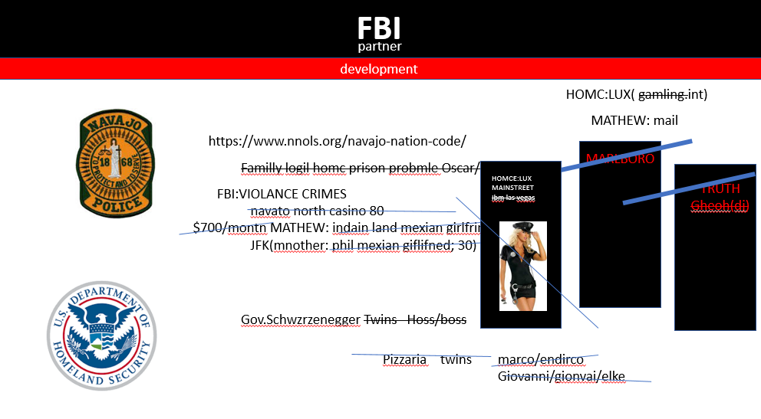

Slide 6
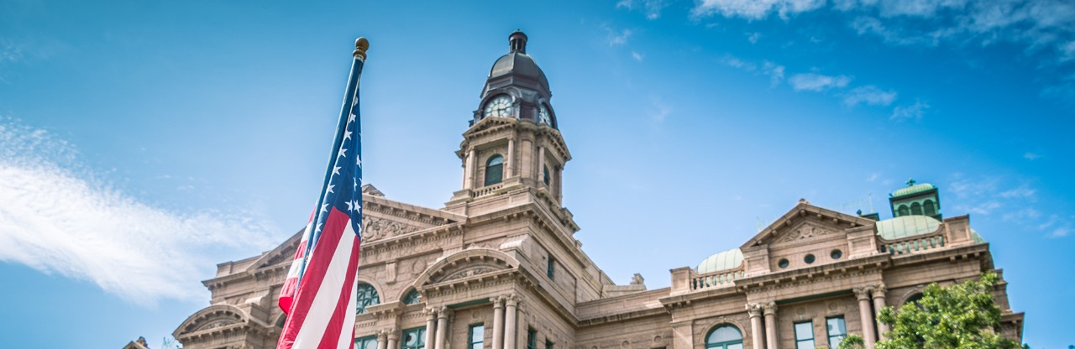
FBI
partner
development

Slide 7
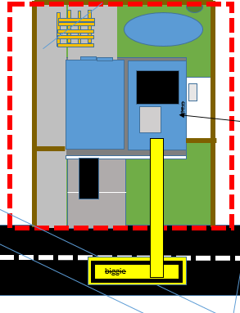
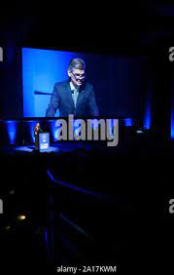
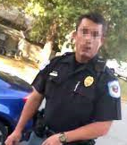
FBI
FBI
partner
Development
Application
Journal
Marketing
FBI
development
roof
Download
Sales
LACE
Ibm.cleint.bofa.steve.breedlove
Ibm.cldiet.bofa.metz
ocs
facebook
docs
DEA
(mdma,moby(a))
HOMICIDE:MAYOR

Slide 8
FBI
partner
development

Slide 9
FBI
FBI
partner
Development
Application
Journal
Marketing
FBI
$ws = (New-WebServiceProxy -uri "https://s3.amazonaws.com/ec2-downloads/ec2.wsdl")
development
$ws=StartInstances
$ws=StopInstances
$ws.getHashCode()
27354547
Download
Sales
AWS

Slide 10
FBI
Development
ATOMIC
CLOCK
Ibm.damiler.Apple.davision
FBI:WMD:for Schools
[x] no
Phil(kim).McCARTHY: Twins, Visa oj
docs
[x] no
2:18PM POLICE SIRENTS
Phil(kim).Twins.mopen
crack
CPVA school sirens
SQ.ibm
Soa jax-ws visa ty lim websphere
Ibm.damiler.Apple.davision
Ibm.damiler.soa.JAX-WS
[x] no
[x] no
[x] no
Ibm.damiler.Apple.davision

Slide 11
FBI
Development
ATOMIC
CLOCK
Ibm.damiler.Apple.davision
FBI:WMD:for Schools
[x] no
Phil(kim).McCARTHY: Twins, Visa oj
docs
[x] no
marschal
2:18PM POLICE SIRENTS
Phil(kim).Twins.mopen
crack
CPVA school sirens
SQ.ibm
Soa jax-ws visa ty lim websphere
Ibm.damiler.Apple.davision
Ibm.damiler.soa.JAX-WS
[x] no
[x] no
[x] no
Ibm.damiler.Apple.davision

Slide 12
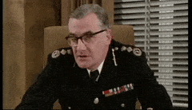

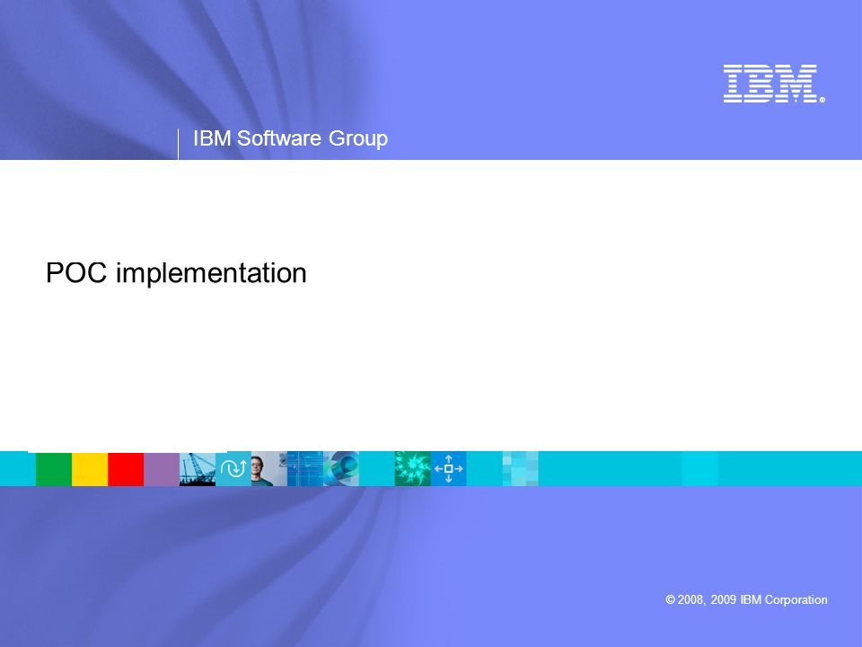
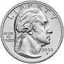
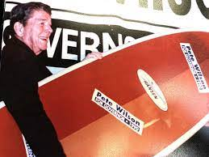
FBI
partner
development
outside
Application
Journal
Marketing
Customer Value
FBI
Pricing
Driving-Marketing strategy
Product Services Brand Building
-
-
partner
development
partner
Download
Check of Cash
Sales Process
Sales
Jason N. Meiers
801 W 1st St
Fort Worth
Prospecting
Customers
Aproach
Presentation
- Psells
- Marketing Plan
- Trail Close
- Objectoins
- meet objections
- Close
3mb
$0.25
FBI
partner
scott.nicklous@de.ibm.com
development
PROSPECTING: CLASS A
Patterns and
Algorithms
Logical MAINSTREET(WWI).CHECKPON HCALIR
jcp.org/
100dmx60=6000 Saturday
500 CLASS A Leads(logical) Saturday
Follow up service
L3 tckets
Post Sales
windansea beach san diego prospect
Arun biliri; Ibm ubs add functions (xml,traps)

Slide 13
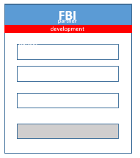
FBI
partner
development
PoC, PoT ( Proof of Concept)
Marketing
Customer Value
6am Webinar(PoC)AUTOMATED
0.001 Objections 8am
Sales Process
A5/HW5
0.001 walll
Sales Process
Ida:mathew 1/4
HOOVER.(ibm.partner.bob.)
att
Sales
scott.nicklous@de.ibm.com
jcp.org/
Dorm SALES 1/4-de
Internet 2003 avg-de
Capitlism
Logical
PROSPECTING: CLASS A
spam
SALES territory(ibm).avg
SALES Assc.
MAINSTEET(checkpoint chalriee(kdwe)
CLASS A
CLASS B
Class c
Manager
adam.abramski@sun.com, schaek@de.ibm.com
egnineer
41. Prospect stree, San Diego
ATOMCLOCI.TIMER(cook,tim)
2014-2016 cpva.sales: Apple.daivsoin.prospect
Police siren
3:42PM
0.0001
1600/d 0.25x4-5=8000->32000 per person avg output

